Slide 1
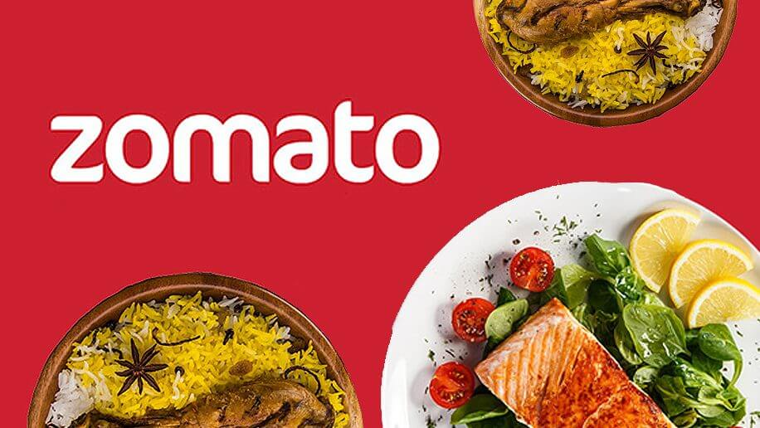
Top Ranked Data Science & Analytics Education Provider since 2007
Zomato CASE STUDY
A research project by Sourav

Slide 2
Contents
This case study consists of 2 data sets.
The first dataset consists of all the Zomato Restaurants details & its service details of 15 countries
The second dataset contains the country code with names where Zomato Exist.

Slide 3
OBJECTIVES
Understand Zomato Business in entire World.
To identify the strategies adopted by various restaurants.
To analyze how Zomato is differ from others.
Analyze relationship between restaurants, food and rating.
To find out which type of restraint is profitable to open in which area.

Slide 4
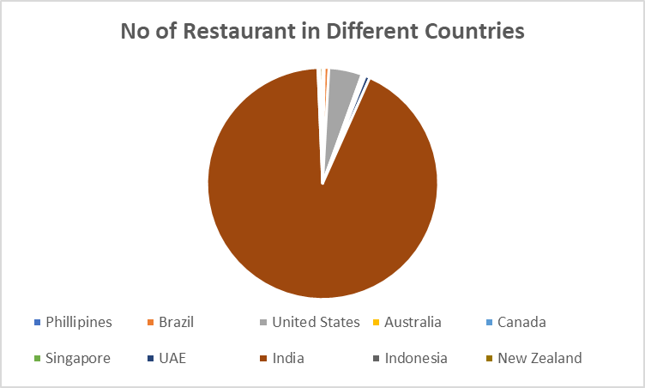
Restaurants Distribution (Country-Wise)
India 93%
United States 5%
Total Restaurant : 9552
Zomato is a Multinational Company Operated in 15 Countries.
By this Distribution I can say that Zomato has maximum business spread (about 93%) across restaurants in India

Slide 5
Business insight
Across 15 Countries Zomato has made the major business from India, as in India 93% restaurants is present in India.
To Understand the Zomato’s Business effectively I need details analysis over India’s Business
Zomato Services has speared over 43 cities in India
In India Total Number of Restaurants is 8,652
Among 8,652 restaurants New Delhi has the Most number (5,473)

Slide 6
Top 5 Cities In India ( Based Upon Number Of Restaurants)
New Delhi : 5473 Faridabad : 251
Gurgaon : 1118 Ghaziabad : 25
Noida : 1080

Slide 7
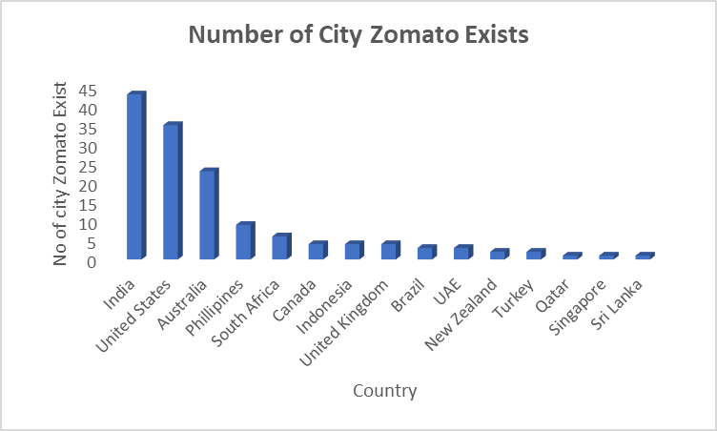
City Distribution Among 15 Countries
India 43
US 35
Australia 25
Rest 12 countries in single digit

Slide 8
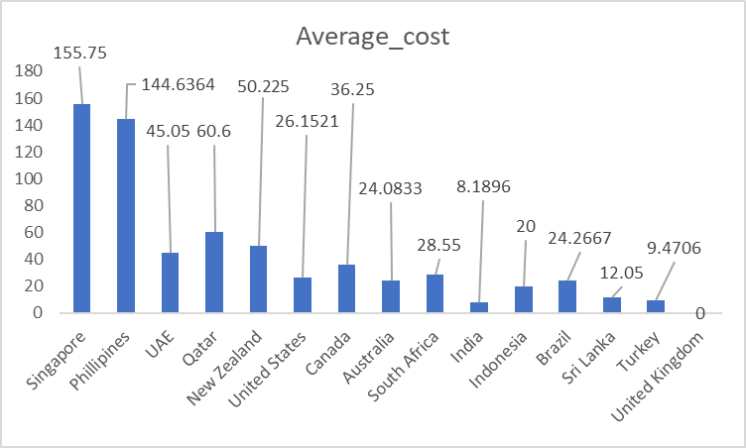
Average Cost (in Dollar) Distribution of Various Country
Singapore
Philippines
UAE
Qatar
New Zealand
Position
* All values are in Dollar($)
It seems that India has the lowest price for two amongst the 15 restaurants.

Slide 9
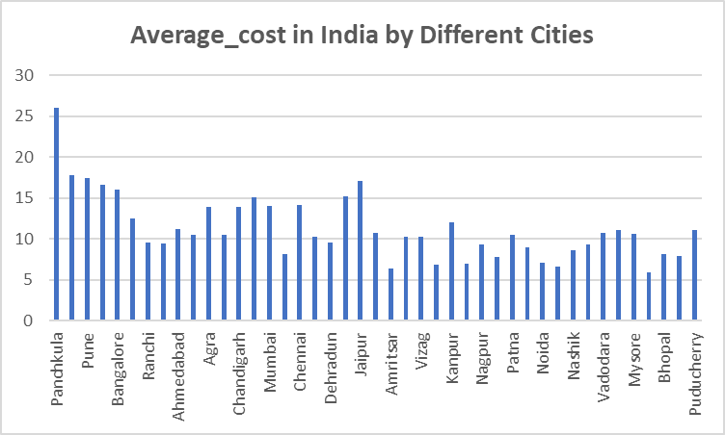
Average Cost in India in all cities
Top 5 Cities In India (Based on Cost)
Most Expensive City
Panchkula
Most Chip City
Faridabad

Slide 10
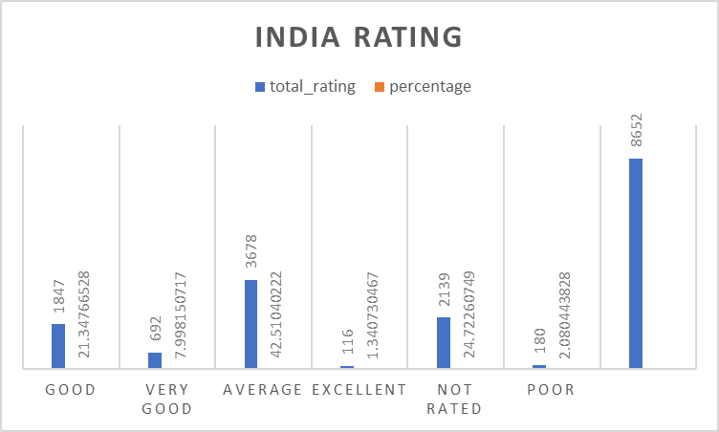
US Vs India Rating Distribution
In US Percentage of Good Rating Is more than India . So Service is batter in Us than India
A major of Indian restaurant ratings are zero.

Slide 11
Online Delivery Distribution
Only 25% of restaurants accept online delivery. This data might be biased as we have 72% restaurants in India not taking online delivery

Slide 12
Rating Distribution
Total 68 Restaurants with more than 4.5 Rating
Among them 24 are in India
In New Delhi only 17 Restaurants have more than 4.5 Rating
Among all only 435 restaurants have online table booking and online delivery
Where in India the number is 427

Slide 13
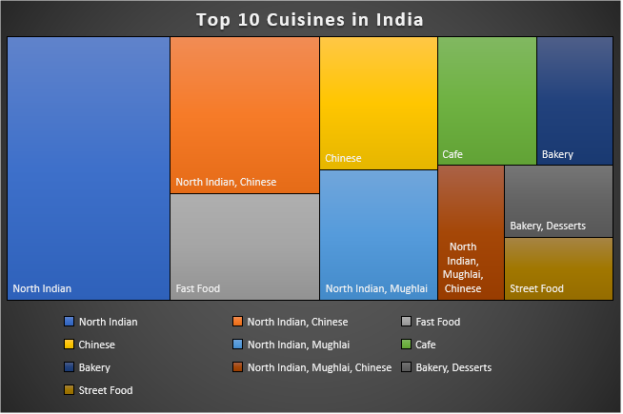
Top 10 Cuisines in India
North Indian, Chinese, Fast food, Mughlai are a few popular cuisines in India, so new restaurants opening up in this space can face stiff competition from established restaurants.
The potential for growth in south Indian cuisines seems good due to the lack of competition and variety of vegetarian dishes.

Slide 14
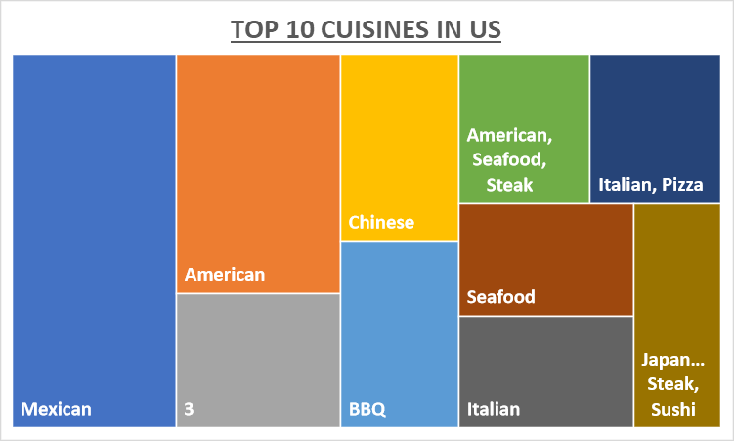
Top 10 Cuisines in United States

Slide 15
Summary of Analysis
India has the most number of Restaurants situated in 43 different cities, where in New Delhi has the maximum number.
Mostly Costly Country is Singapore and most cheapest country is India.
In India Panchkula city is most costly and Faridabad is chipset . Where New Delhi is also a cheaper city.
Service is batter in Us than India .
A major of Indian restaurant ratings are zero.
North Indian, Chinese, Fast food, Mughlai are a few popular cuisines in India.
south Indian cuisines seems have lack of competition.
Only 25% of restaurants accept online delivery.
In New Delhi Connaught place has more number restaurants so in this area competition will more
Where Aaya nagar, Aerocity, AARS Mall etc number of restaurants is 1 so it could be the right place to open a new Restaurants

Slide 16
Thank You

